Slide 1
Data Structure and Algorithm CSE-225
Dr. Mohammad Abu Yousuf
yousuf@juniv.edu

Slide 2
Pointer
A pointer is a variable which contains the address in memory of another variable. We can have a pointer to any variable type.
The operator & gives the “address of a variable”.
The indirection or dereference operator * gives the “contents of an object pointed to by a pointer”.
To declare a pointer to a variable do:
int *p;

Slide 3
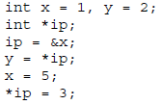
Pointer
Consider the effect of the following code:

Slide 4
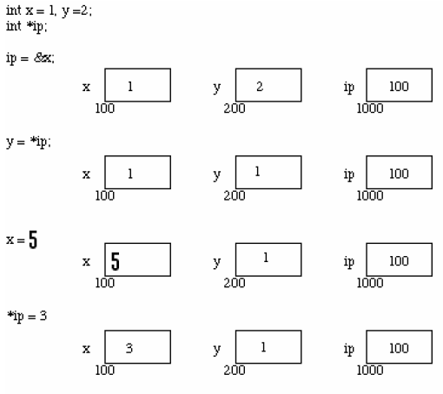
Pointer

Slide 5
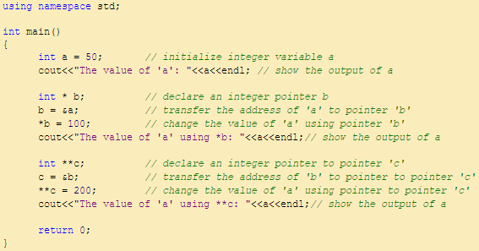

Pointer

Slide 6
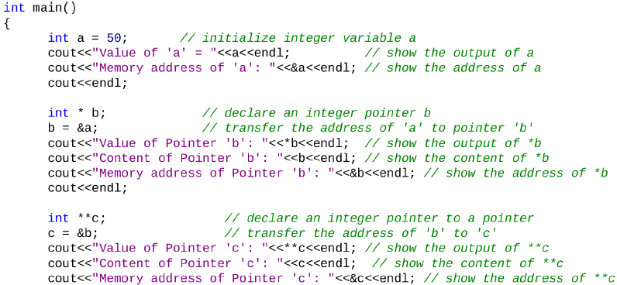

Pointer

Slide 7
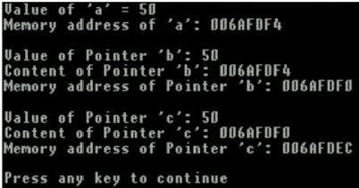
Pointer
Output of previous program:

Slide 8
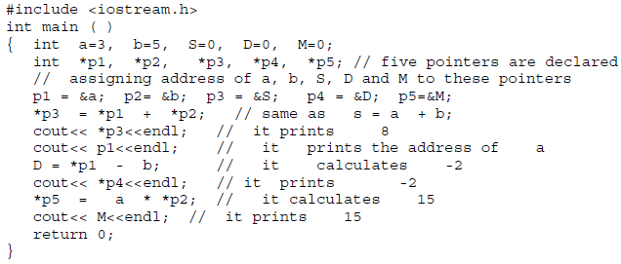
Pointer
Here is another example program which will describes the usage of pointers and the contents of pointers.

Slide 9

Pointers and Arrays
Pointers and arrays are very closely linked in C.
Think of array elements arranged in consecutive / successive memory locations.
Consider the following:
The elements of the above given array will be stored as pictured in the following figure. Each element of the array occupies 4 bytes (due to int). Assume first element is stored at address 100, second element will store at address 104 and so on:

Slide 10
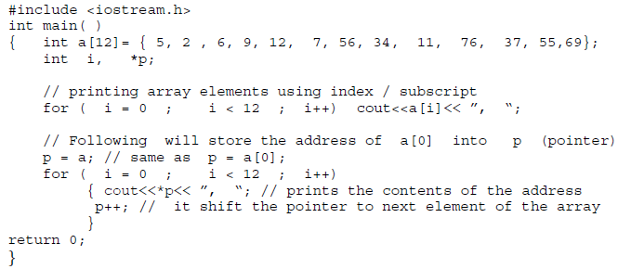
Pointers and Arrays
Prints contents of all elements using pointers

Slide 11
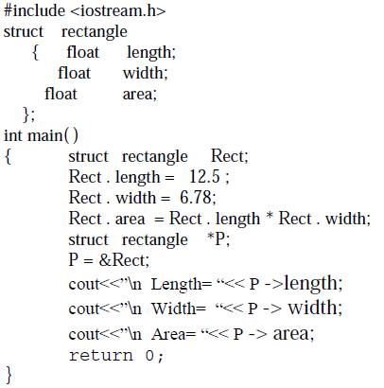
Pointers and Structures
Program to describe the pointer to structures

Slide 12
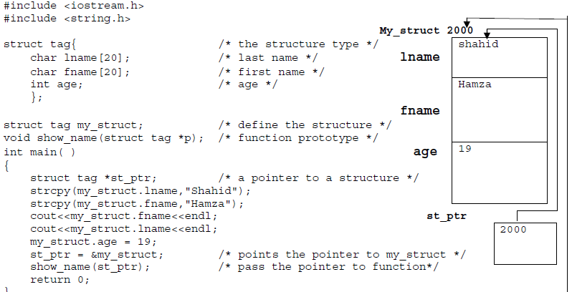
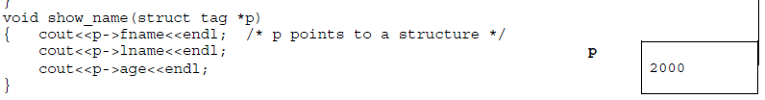
Another program to describe the pointer to structures. // It is assumed that structure variable is stored at location 2000 in memory

Slide 13
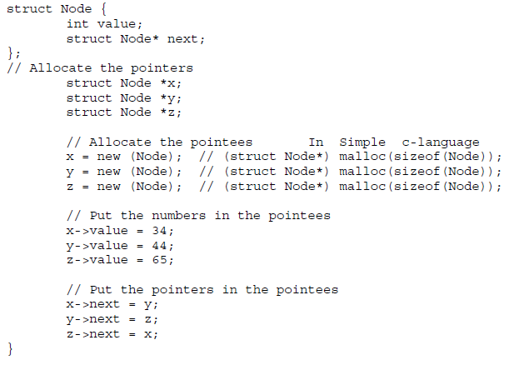
Another example

Slide 14
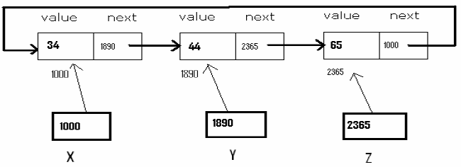
Explanation of previous program :

Slide 15
Thank you

